Slide 1

CyberGuard
CYBERSECURITY PROJECT
Protecting users from online threats
Stopping phishing and online fraud before the click.
Who really owns this link?
https://meridiancloud.com.
account-verify.net
/signin
The real owner is account-verify.net. Everything in front of it is decoration.
Presented by Mahalakshmi S.
Notes:
Introduce CyberGuard: a web app that helps people stop phishing and online fraud before they click. The link on this slide is a real pattern: the company name sits in front, but the owner is the last two parts before the first single slash.

Slide 2
The problem: one click is enough
Phishing and fraud succeed because they target people, not software.
62%
3.8M
21.8 lakh
1 in 5
of data breaches involved the human element
phishing attacks recorded worldwide in 2025
cyber-fraud complaints in India in 2025, about Rs 19,800 crore lost
UPI-user households hit by fraud in three years
Verizon DBIR 2026
APWG, Q4 2025 report
I4C data via IANS
LocalCircles, 32,000+ responses
Why it works
PROBLEM STATEMENT
People cannot reliably tell a real link from a fake one in the moment, and have no safe place to check or practise before they click.
Decoy and lookalike domains pass a quick glance
Urgency on trusted channels (SMS, UPI, QR) rushes people past checking
40% of UPI fraud victims tapped a payment link to receive money, and 51% never reported it
Sources: Verizon 2026 DBIR; APWG Q4 2025; I4C via IANS, Jan 2026; LocalCircles via Business Standard, Jun 2025
Notes:
Talking points. (1) Verizon 2026 DBIR, as summarised by Abnormal AI: the human element was involved in 62% of breaches. (2) APWG recorded about 3.8 million phishing attacks in 2025, slightly above 2024; wire-transfer business email compromise rose 136% in Q4 versus Q3 (Fortra). (3) I4C data reported by IANS in January 2026: roughly 21.8 lakh cheating complaints and about Rs 19,800 crore lost in 2025, after Rs 22,849 crore in 2024. (4) LocalCircles survey of 32,000+ UPI users in 365 districts: one in five households hit by fraud in three years; among victims, 40% tapped a payment link to receive money and were debited, 20% scanned a QR code, 20% shared an OTP or PIN with an impersonator, and 51% did not complain anywhere. Domain point: decoy subdomains (meridiancloud.com.account-verify.net) and lookalike characters (meridianc1oud.com) defeat quick visual checks, which is why the tool reads the real domain for the user.

Slide 3
The solution: check before you click
Read the real address, score the signals, give a clear verdict, then build the habit.
1. Message arrives
A link, SMS or email the user is unsure about, pasted into the analyzer
2. Read the address
Split the real domain from decoy subdomains, lookalike letters and @ tricks
3. Score the signals
Link: IP host, odd endings, shorteners. Wording: urgency, OTP or PIN asks
4. Risk verdict
Signals add up to a score from 0 to 100 with the reasons listed
Build the habit
Briefing deck and 7-message simulator teach the same checks
Low risk (under 20)
Nothing matches scam patterns. Still open the site yourself
Suspicious (20 to 49)
Verify through the official app or a number you trust
Likely phishing (50+)
Do not click. Report: 1930, cybercrime.gov.in
All checks run in the browser, so nothing you paste leaves the page.
Notes:
Walk left to right. The analyzer reads the real domain first because decoy subdomains and lookalike letters are the tricks that defeat a quick glance. Signals are scored independently (link signals and wording signals) and added up, so no single signal decides. Thresholds: under 20 low, 20 to 49 suspicious, 50 and above likely phishing. The briefing and simulator feed the same four checks (sender, destination, pressure, the ask) so users get faster before they ever need the analyzer. Everything runs client-side, so pasted messages are never uploaded.

Slide 4
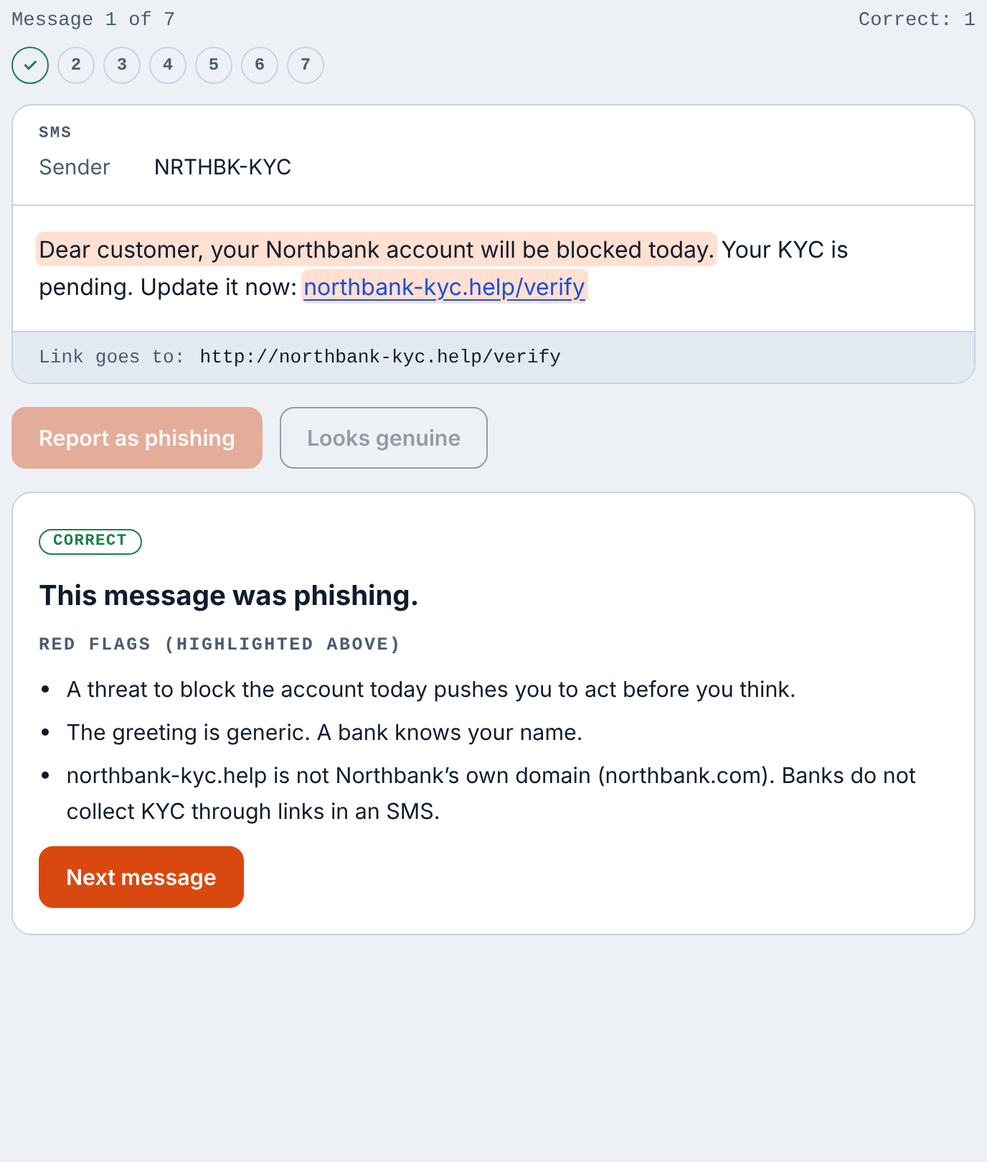
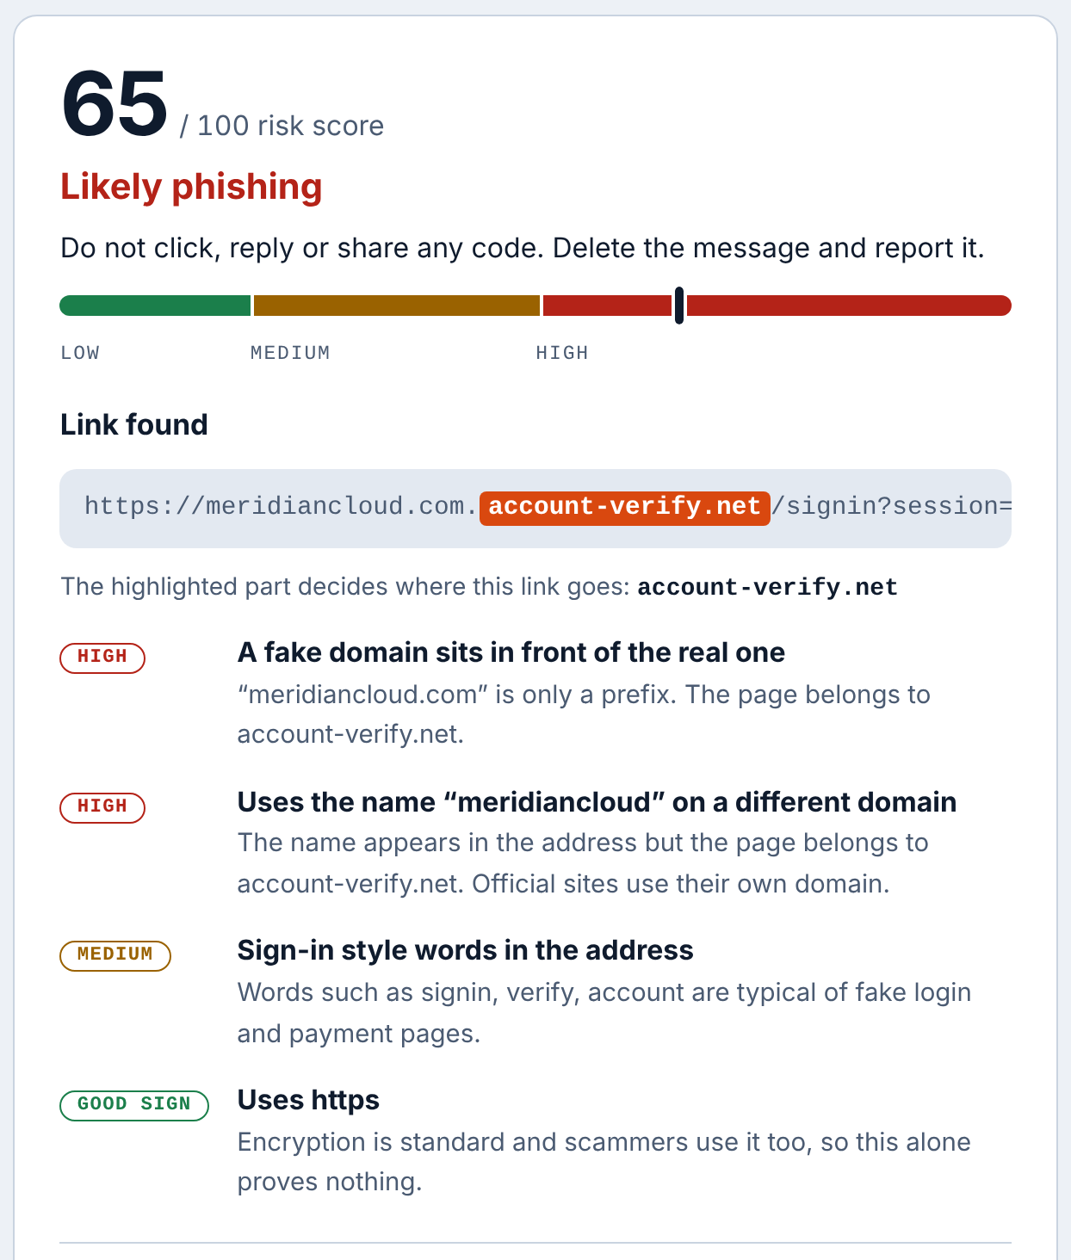
The prototype: CyberGuard web app
A working site built with HTML, CSS and JavaScript. It runs fully in the browser.
Briefing deck
Eight interactive slides on how phishing works
Threat simulator
Seven fictional messages. Hover links, get instant feedback
Security analyzer
Risk score from 0 to 100 for any link or message
Light and dark themes, phone-friendly layout, no data leaves the page.
Simulator: red flags and real link shown after each answer
Analyzer: 65 out of 100, likely phishing, with reasons
Notes:
Show the live site if possible. Simulator: seven fictional messages (SMS, email, UPI prize, boss gift-card request); after each answer the red flags are highlighted and the real link destination is shown. Analyzer: paste a link or message and get a 0 to 100 risk score, a plain-language verdict and the reasons. Screens are from the working prototype.

